Slide 1
Introduction to Machine Learning ARM-206 Unit-II

Slide 2
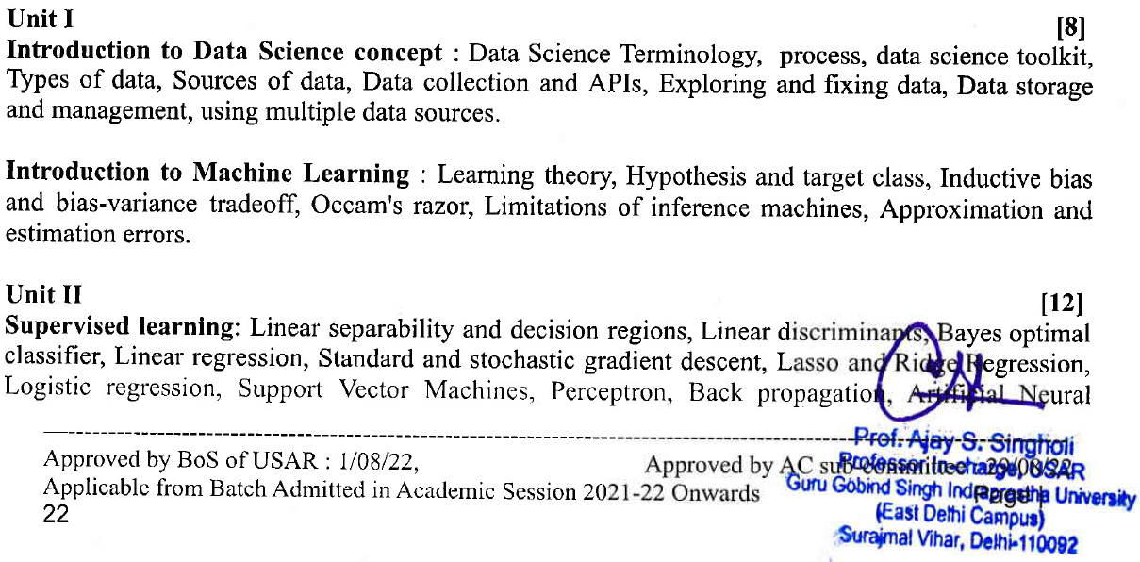
SYLLABUS

Slide 3
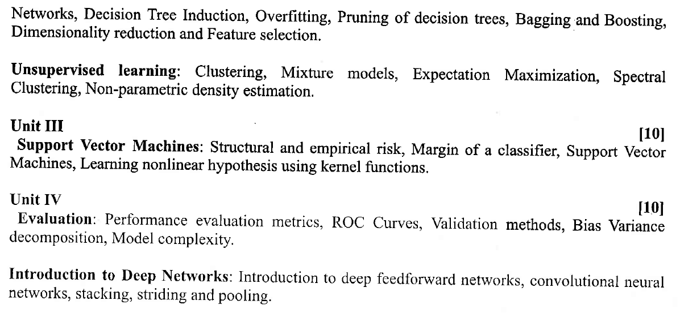
SYLLABUS

Slide 4
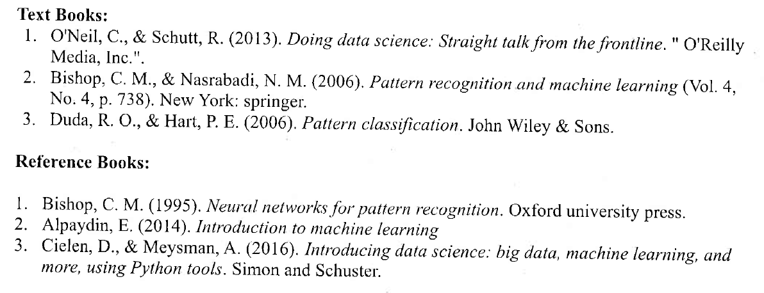

Slide 5
Supervised Machine Learning
Supervised learning is the types of machine learning in which machines are trained using well "labelled" training data, and on basis of that data, machines predict the output. The labelled data means some input data is already tagged with the correct output.
In supervised learning, the training data provided to the machines work as the supervisor that teaches the machines to predict the output correctly. It applies the same concept as a student learns in the supervision of the teacher.
Supervised learning is a process of providing input data as well as correct output data to the machine learning model. The aim of a supervised learning algorithm is to find a mapping function to map the input variable(x) with the output variable(y).
In the real-world, supervised learning can be used for Risk Assessment, Image classification, Fraud Detection, spam filtering, etc.

Slide 6
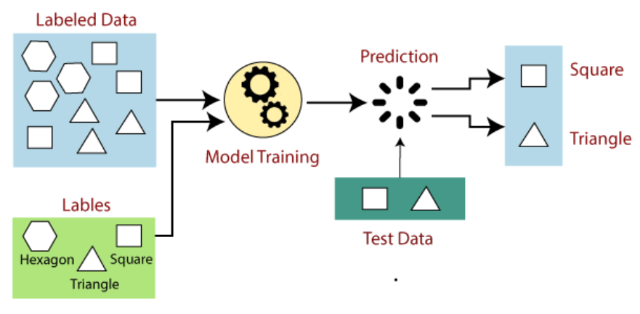
How Supervised Learning Works?
In supervised learning, models are trained using labelled dataset, where the model learns about each type of data. Once the training process is completed, the model is tested on the basis of test data (a subset of the training set), and then it predicts the output.

Slide 7
Steps Involved in Supervised Learning
First Determine the type of training dataset
Collect/Gather the labelled training data.
Split the training dataset into training dataset, test dataset, and validation dataset.
Determine the input features of the training dataset, which should have enough knowledge so that the model can accurately predict the output.
Determine the suitable algorithm for the model, such as support vector machine, decision tree, etc.
Execute the algorithm on the training dataset. Sometimes we need validation sets as the control parameters, which are the subset of training datasets.
Evaluate the accuracy of the model by providing the test set. If the model predicts the correct output, which means our model is accurate.

Slide 8
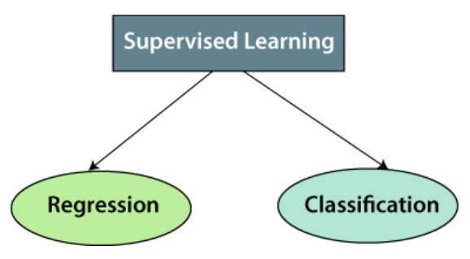
Types of supervised Machine learning Algorithms
Supervised learning can be further divided into two types of problems:

Slide 9
1. Regression
Regression algorithms are used if there is a relationship between the input variable and the output variable. It is used for the prediction of continuous variables, such as Weather forecasting, Market Trends, etc.
Below are some popular Regression algorithms which come under supervised learning:
Linear Regression
Regression Trees
Non-Linear Regression
Bayesian Linear Regression
Polynomial Regression

Slide 10
2. Classification
Classification algorithms are used when the output variable is categorical, which means there are two classes such as Yes-No, Male-Female, True-false, etc. Multiclass classification is also possible.
Spam Filtering,
Random Forest
Decision Trees
Logistic Regression
Support vector Machines

Slide 11
Unsupervised Machine Learning
As the name suggests, unsupervised learning is a machine learning technique in which models are not supervised using training dataset. Instead, models itself find the hidden patterns and insights from the given data. It can be compared to learning which takes place in the human brain while learning new things.
Unsupervised learning is a type of machine learning in which models are trained using unlabeled dataset and are allowed to act on that data without any supervision.
Unsupervised learning cannot be directly applied to a regression or classification problem because unlike supervised learning, we have the input data but no corresponding output data. The goal of unsupervised learning is to find the underlying structure of dataset, group that data according to similarities, and represent that dataset in a compressed format.

Slide 12
Why use Unsupervised Learning?
Below are some main reasons which describe the importance of Unsupervised Learning:
Unsupervised learning is helpful for finding useful insights from the data.
Unsupervised learning is much similar as a human learns to think by their own experiences, which makes it closer to the real AI.
Unsupervised learning works on unlabeled and uncategorized data which make unsupervised learning more important.
In real-world, we do not always have input data with the corresponding output so to solve such cases, we need unsupervised learning.

Slide 13
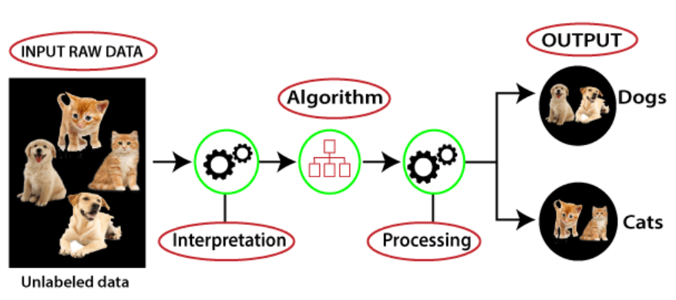
Working of Unsupervised Learning
Here, we have taken an unlabeled input data, which means it is not categorized and corresponding outputs are also not given. Now, this unlabeled input data is fed to the machine learning model in order to train it. Firstly, it will interpret the raw data to find the hidden patterns from the data and then will apply suitable algorithms such as k-means clustering, Decision tree, etc.
Once it applies the suitable algorithm, the algorithm divides the data objects into groups according to the similarities and difference between the objects.

Slide 14
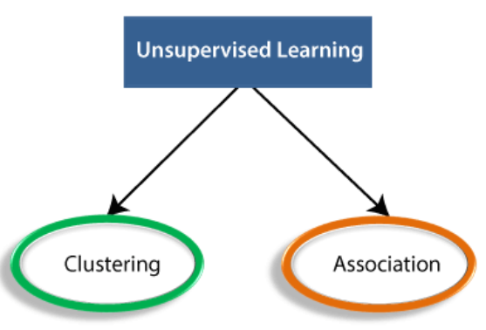
Types of Unsupervised Learning Algorithm
The unsupervised learning algorithm can be further categorized into two types of problems:
Clustering: Clustering is a method of grouping the objects into clusters such that objects with most similarities remains into a group and has less or no similarities with the objects of another group. Cluster analysis finds the commonalities between the data objects and categorizes them as per the presence and absence of those commonalities.
Association: An association rule is an unsupervised learning method which is used for finding the relationships between variables in the large database. It determines the set of items that occurs together in the dataset. Association rule makes marketing strategy more effective. Such as people who buy X item (suppose a bread) are also tend to purchase Y (Butter/Jam) item. A typical example of Association rule is Market Basket Analysis.

Slide 15
Unsupervised Learning algorithms
Below is the list of some popular unsupervised learning algorithms:
K-means clustering
KNN (k-nearest neighbors)
Hierarchal clustering
Anomaly detection
Neural Networks
Principle Component Analysis
Independent Component Analysis
Apriori algorithm
Singular value decomposition

Slide 16

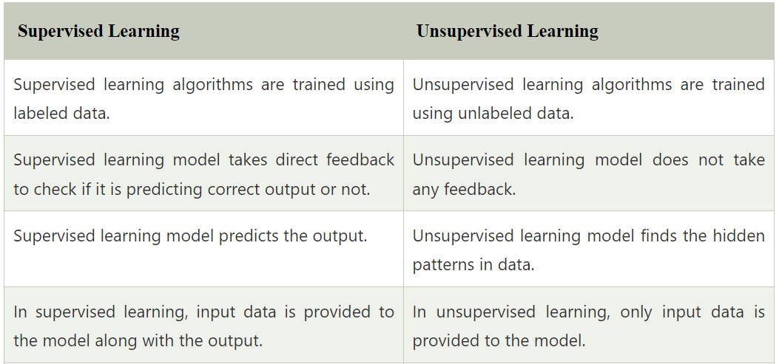
Difference between Supervised and Unsupervised Learning

Slide 17
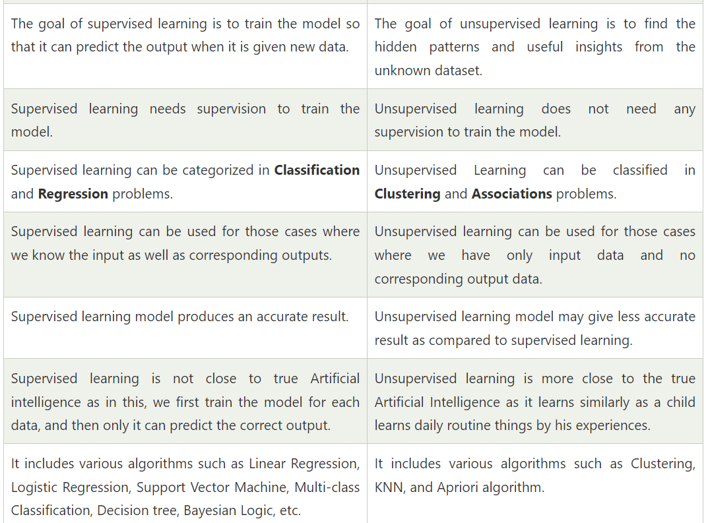
Difference between Supervised and Unsupervised Learning

Slide 18
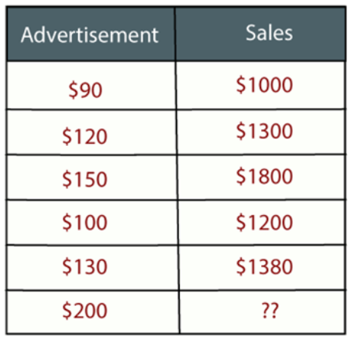
Regression Analysis in Machine learning
Regression analysis helps us to understand how the value of the dependent variable is changing corresponding to an independent variable when other independent variables are held fixed. It predicts continuous/real values such as temperature, age, salary, price, etc.
Example: Suppose there is a marketing company A, who does various advertisement every year and get sales on that. The below list shows the advertisement made by the company in the last 5 years and the corresponding sales:
Now, the company wants to do the advertisement of $200 in the year 2019 and wants to know the prediction about the sales for this year. So to solve such type of prediction problems in machine learning, we need regression analysis.

Slide 19
Regression Analysis in Machine learning
In Regression, we plot a graph between the variables which best fits the given datapoints, using this plot, the machine learning model can make predictions about the data.
In simple words, "Regression shows a line or curve that passes through all the datapoints on target-predictor graph in such a way that the vertical distance between the datapoints and the regression line is minimum."
The distance between datapoints and line tells whether a model has captured a strong relationship or not.

Slide 20
Why do we use Regression Analysis?
Regression estimates the relationship between the target and the independent variable.
It is used to find the trends in data.
It helps to predict real/continuous values.
By performing the regression, we can confidently determine the most important factor, the least important factor, and how each factor is affecting the other factors.

Slide 21
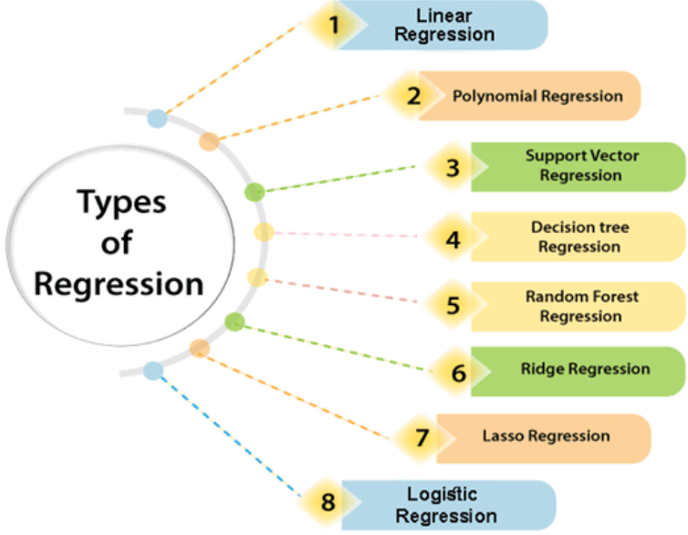
Types of Regression
There are various types of regressions which are used in data science and machine learning. Each type has its own importance on different scenarios, but at the core, all the regression methods analyze the effect of the independent variable on dependent variables.

Slide 22
Linear Regression
Linear regression shows the linear relationship between the independent variable (X-axis) and the dependent variable (Y-axis), hence called linear regression.
If there is only one input variable (x), then such linear regression is called simple linear regression. And if there is more than one input variable, then such linear regression is called multiple linear regression.
The relationship between variables in the linear regression model can be explained using the below image. Here we are predicting the salary of an employee on the basis of the year of experience.

Slide 23
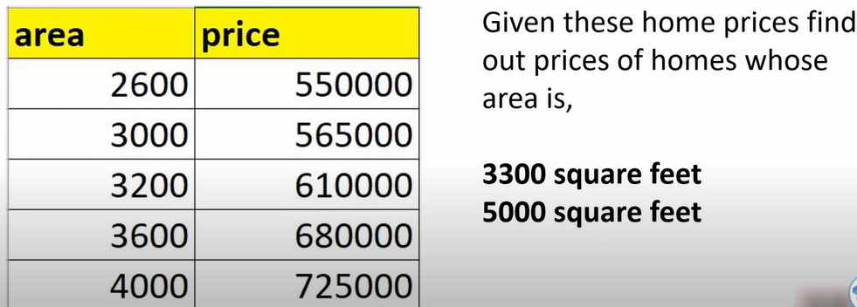
Simple Linear Regression

Slide 24
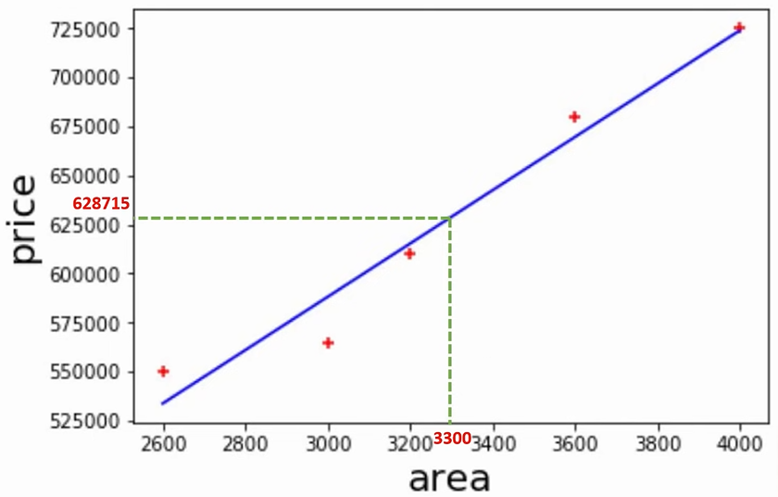
Simple Linear Regression
We can plot all the data points.
The Blue line best fits in these data points. But why only this line as it doesn’t cross all the data points???

Slide 25
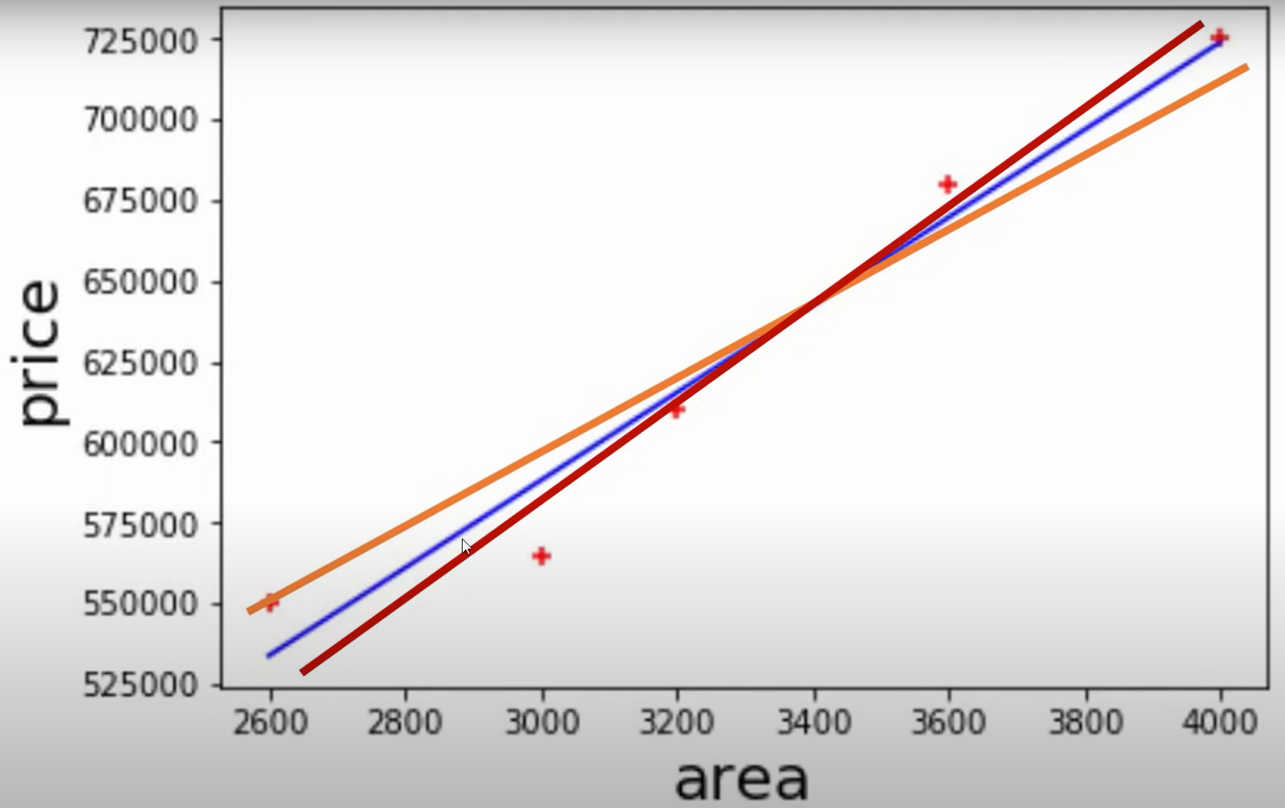
Simple Linear Regression
We can draw lines in a number of ways…

Slide 26
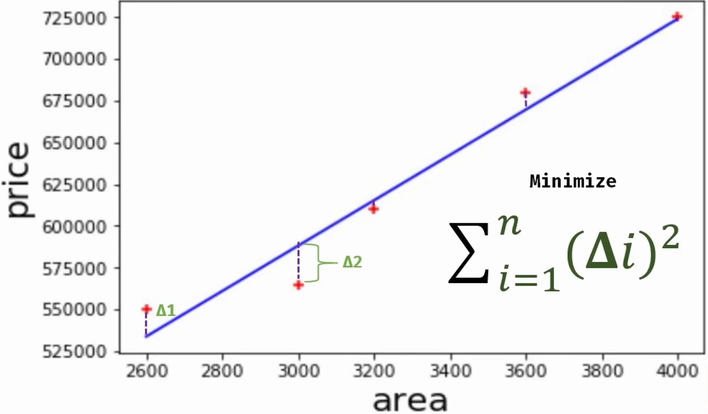
Simple Linear Regression
Why only Blue line??
Calculate the error for all the lines and finalize the line with least error. That is Blue line.

Slide 27
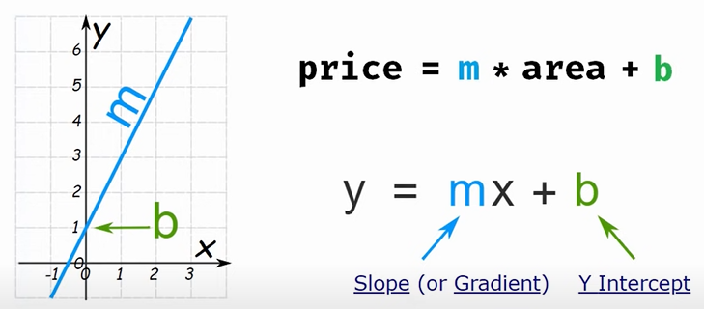
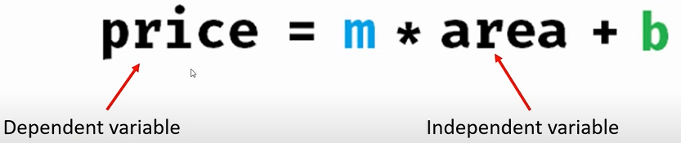
Simple Linear Regression

Slide 28
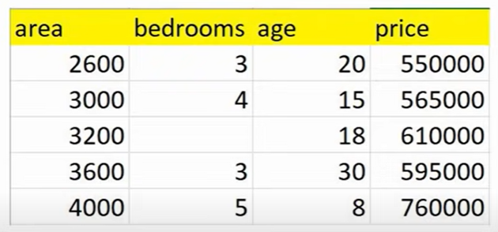
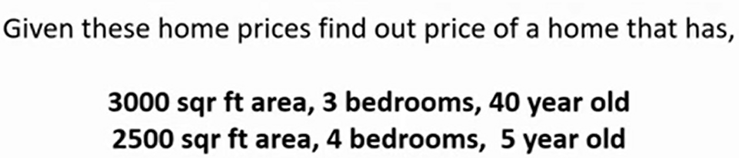
Multiple Linear Regression
Linear Regression with multiple variables (Multivariate Regression)

Slide 29
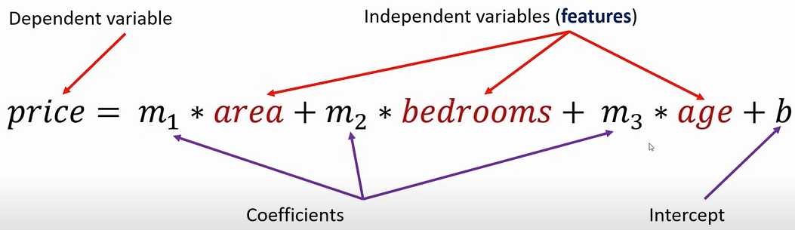
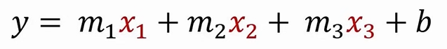
Multiple Linear Regression

Slide 30
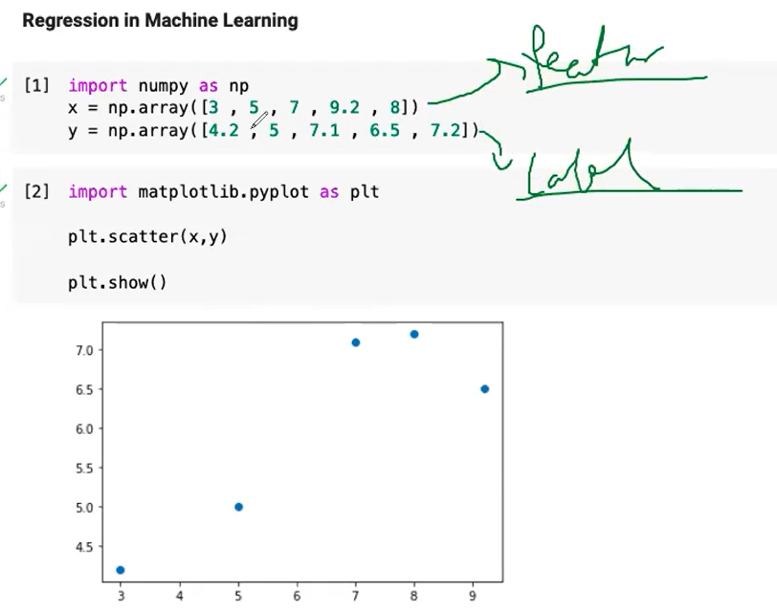
Linear Regression

Slide 31
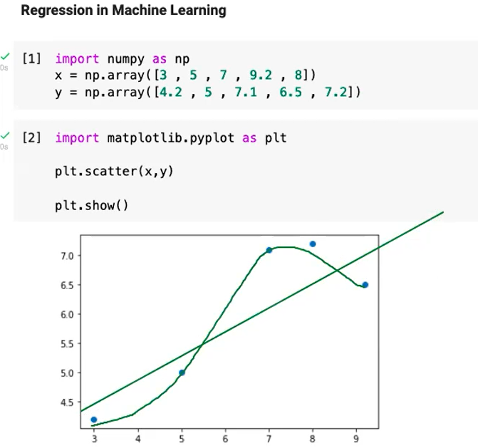
Linear Regression
Algorithm can take some linear approach or some non-linear approach.
No any other option is there…

Slide 32
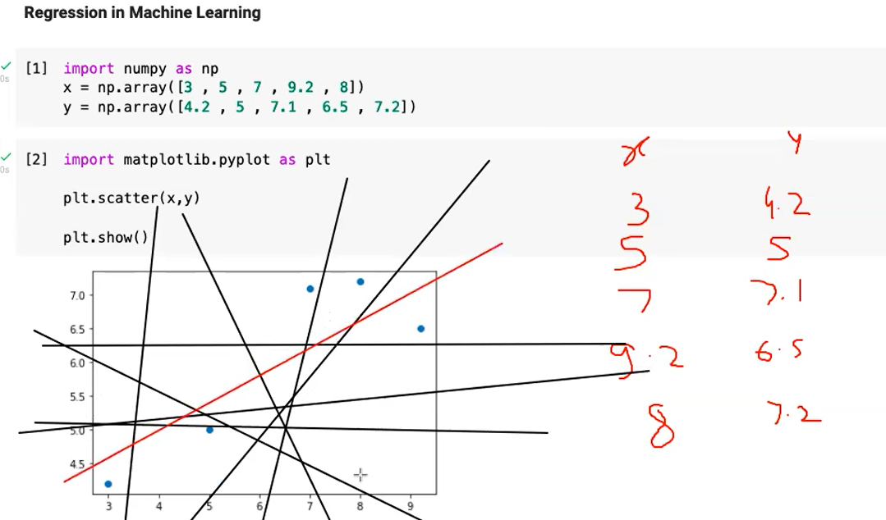
We are considering here only the linear approach

Slide 33
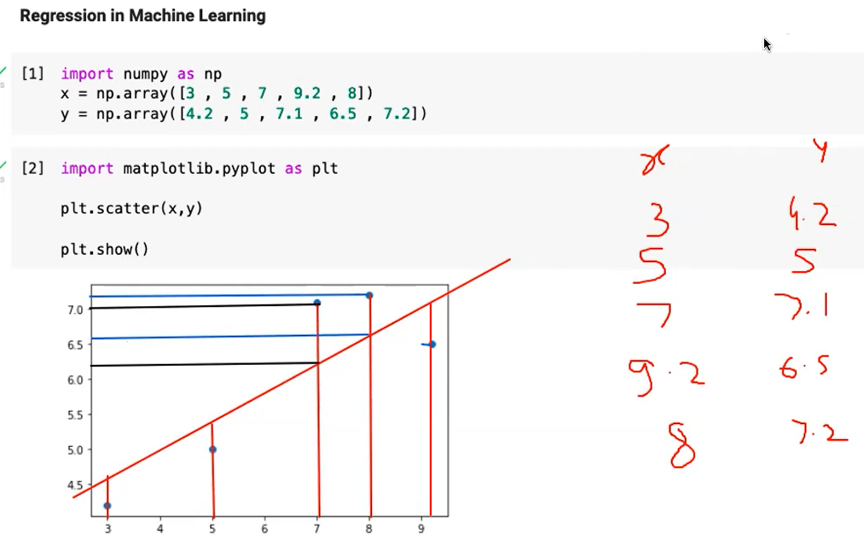

Slide 34
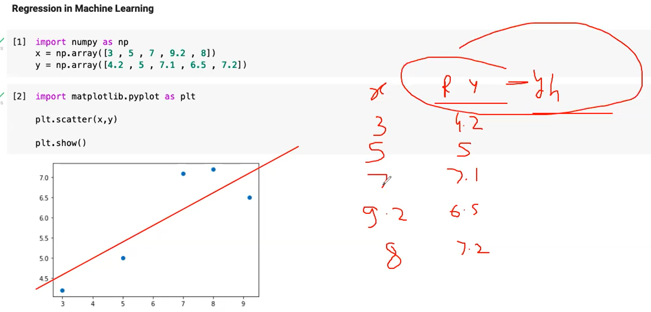
For each value of X, there are two values of Y.
Actual (Real) and
as computed by plotted line
The average difference should be minimum for the line to be termed as best fitted line.
Here, Ry is the real value of Y and Yh is the predicted value of Y

Slide 35
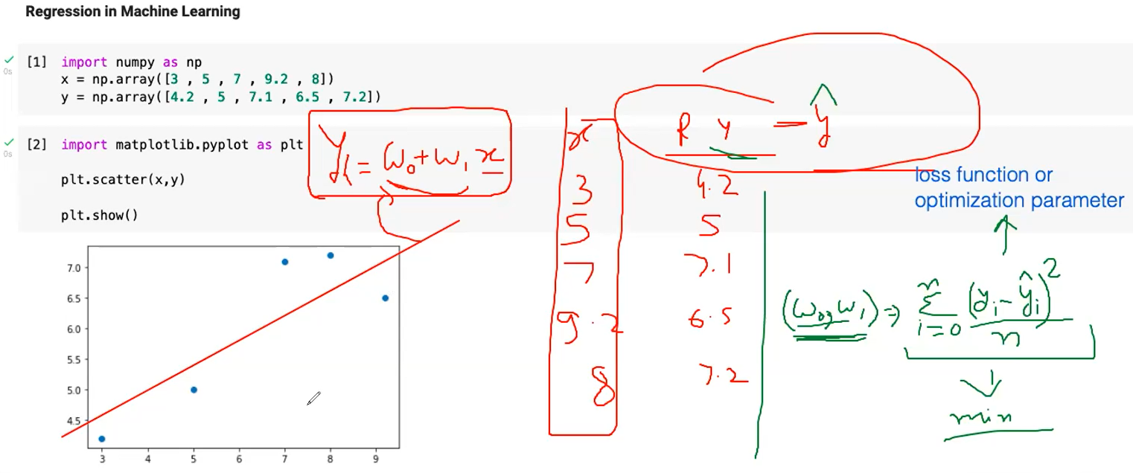
For each value of X, there are two values of Y.
Actual (Real) yi
as computed by plotted line yi hat
The values of w0 and w1 will be such as to choose the best fit line because the values of w0 and w1 are such that the MSE (LOSS FUNCTION) is minimum.

Slide 36
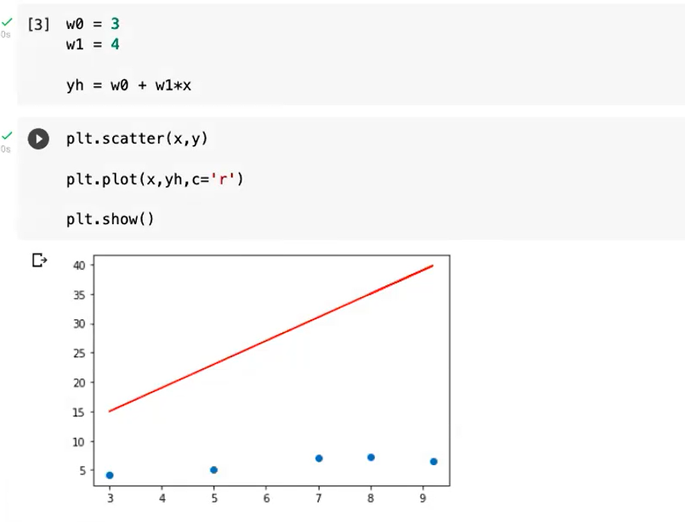
Random plot for w0=3 and w1=4
But this line is not best fit

Slide 37
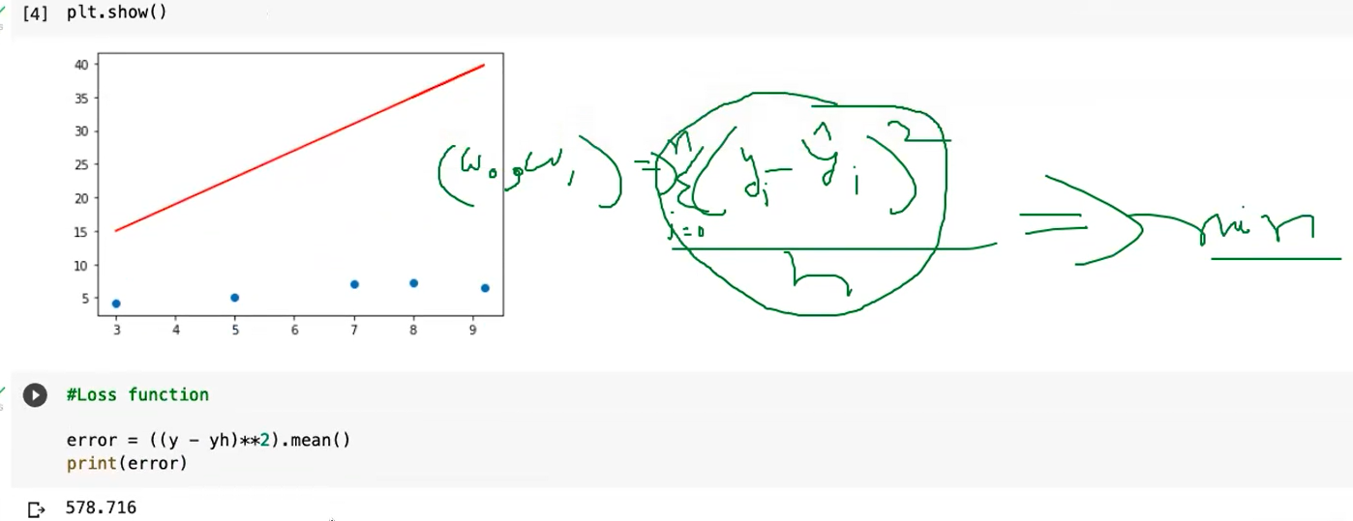
We have calculated Loss Function (error) and next we have to minimize it by implementing error minimization process.
We have to actually tune w0 and w1 so that cost function may become minimum.
Error is 578 approx.

Slide 38
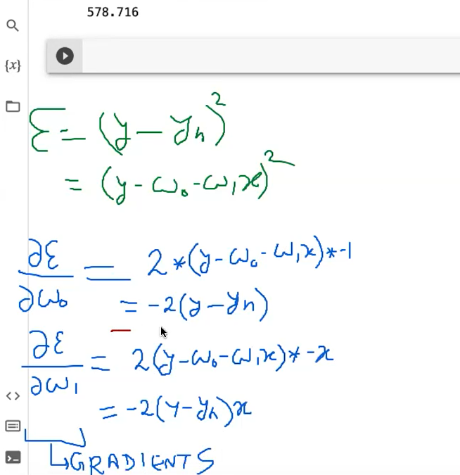
We have to calculate gradient values which are actually the difference between real and calculated values of Y
Because Yh = w1 x + w0
Why we are calculating these things for tuning w0 and w1??

Slide 39
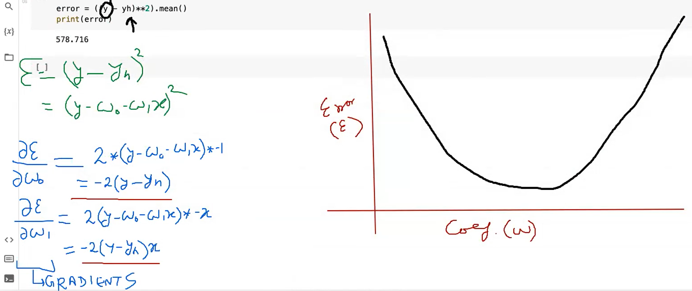
We have to calculate gradient values which are actually the difference between real and calculated values
Error 578.716 calculated here changes with w values because
Y is constant but yh depends on w0 and w1 as we know, Yh = w1 x + w0
Error curve can be of any shape but we have to find the values of coefficient w such that error value is minimum.

Slide 40
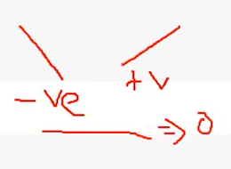
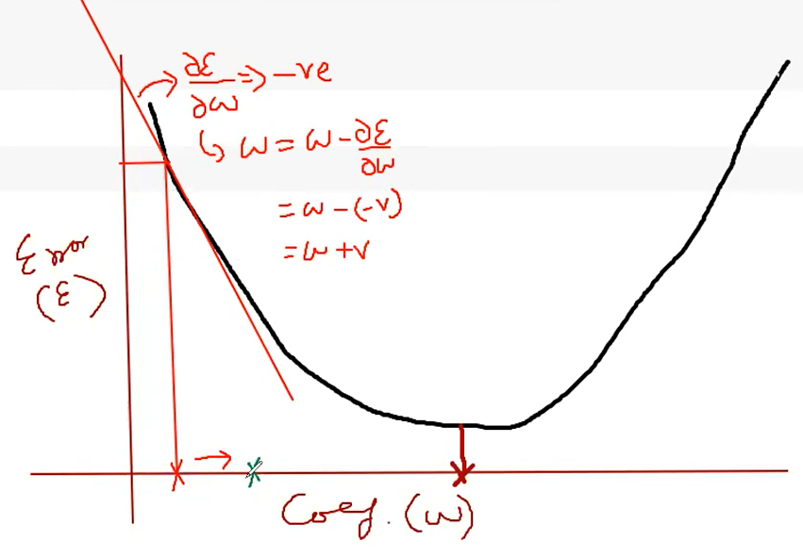
Positive and Negative slopes

Slide 41
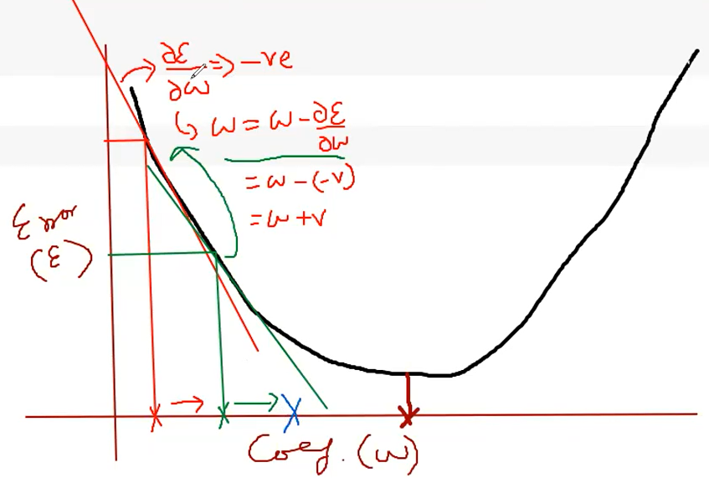

Slide 42
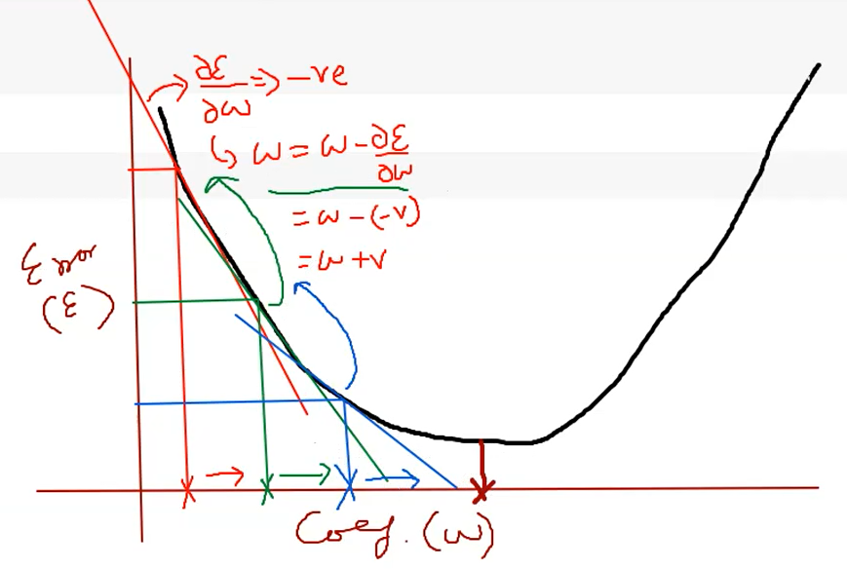

Slide 43
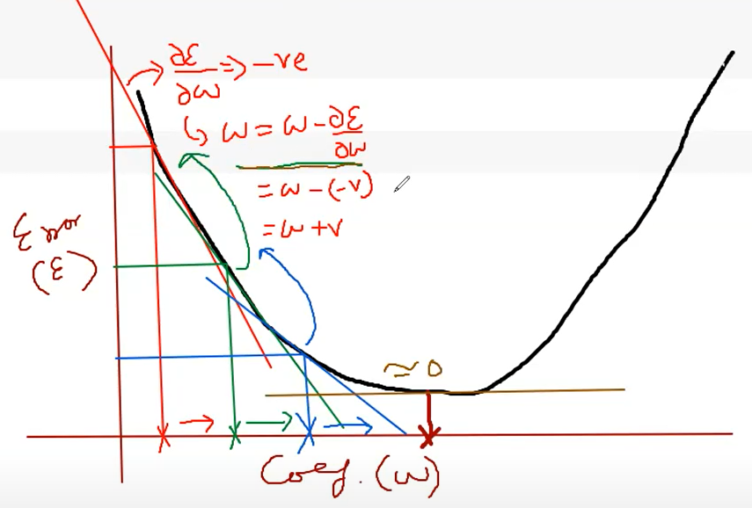
After some time we will reach at a stage where there is no change in w because slope is zero. Zero slope means no change in w.

Slide 44
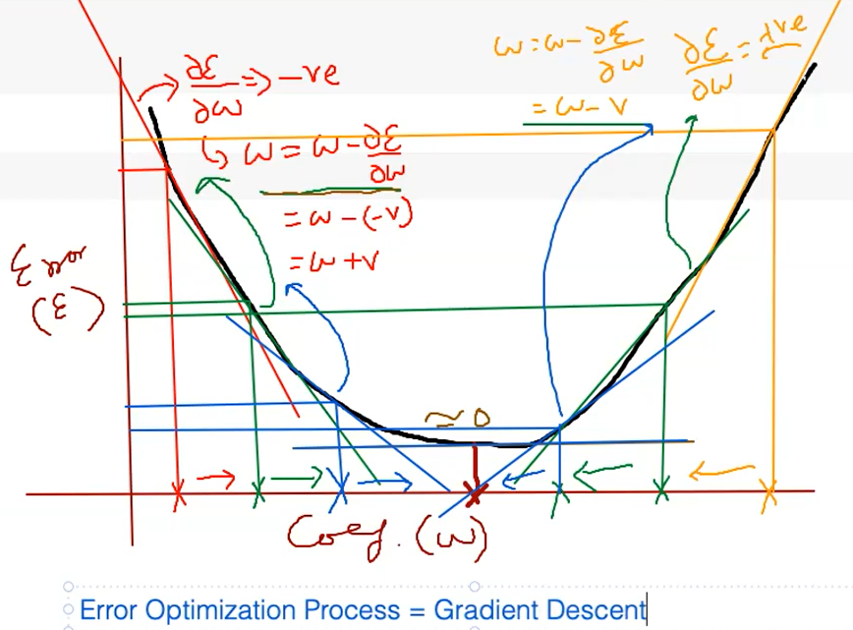
Even if we start with higher initial values of w, after some time we will reach at a stage where there is no change in w because slope is zero. Zero slope means no change in w.
Gradient is continuously descending on the curve.

Slide 45
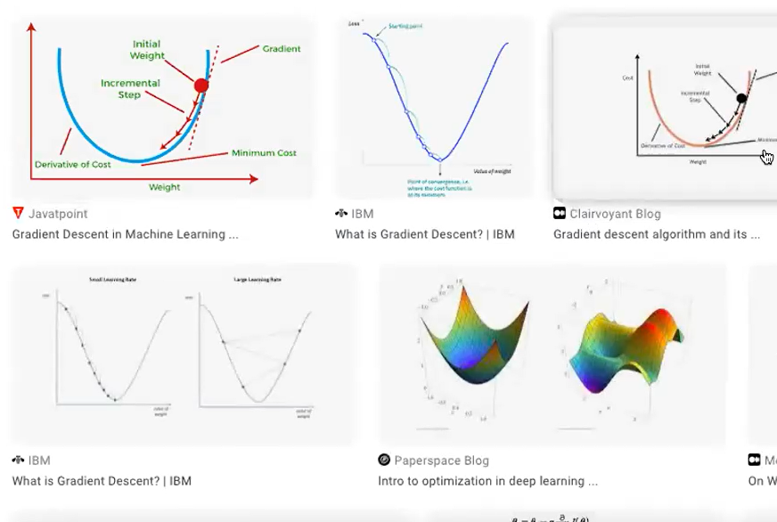
Some sample curves to demonstrate error curve /surface

Slide 46
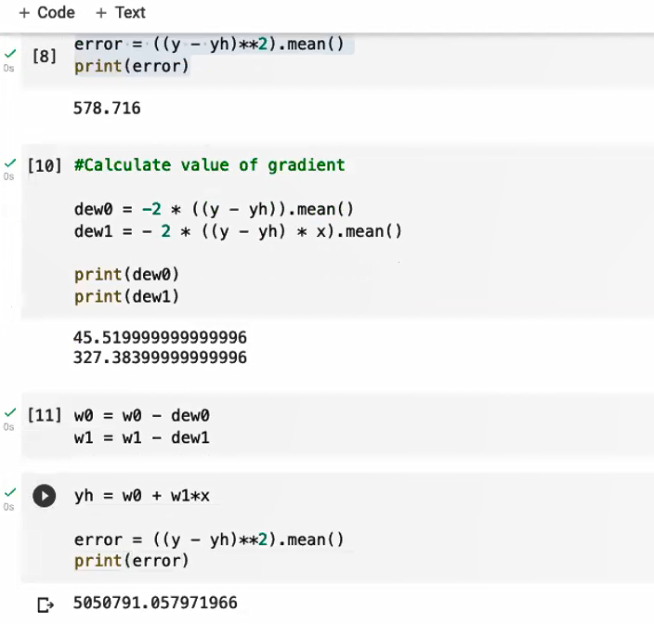
Here, we are calculating the error after weight update after calculating error gradient.
Error is very large (earlier error was 578). So, next, we will try to regularize the weights by adding some regularization parameters – called Learning Rate

Slide 47
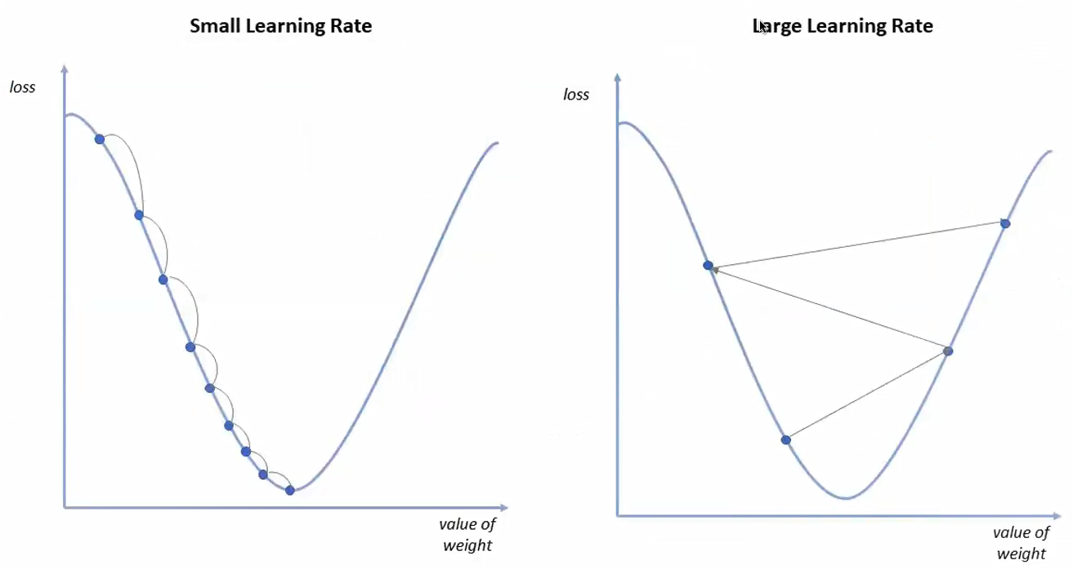
If we want to optimize the error, we have to take small steps.
Question:- Who can control the step size??

Slide 48
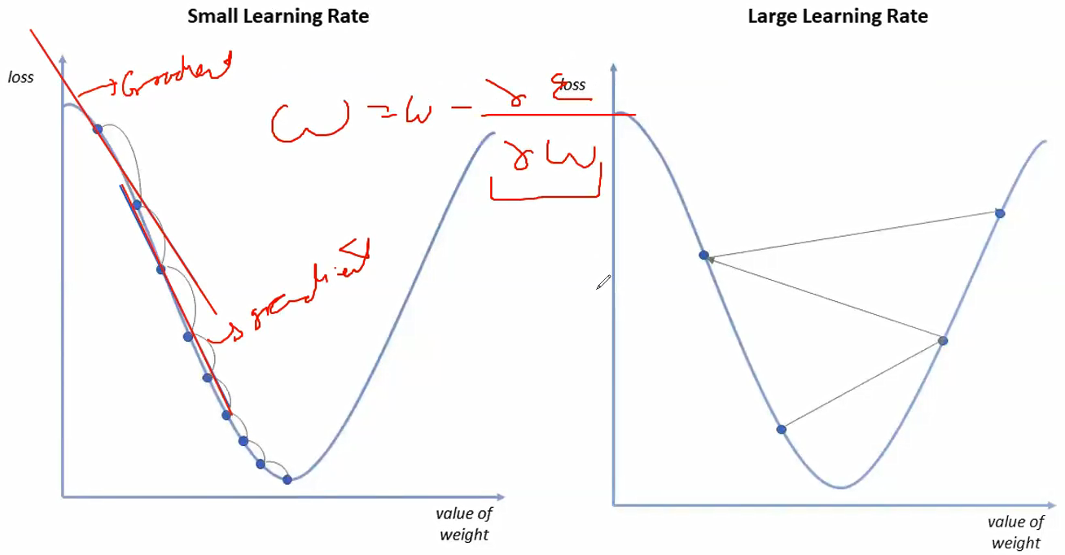
Answer: Gradient at a point decides the step size. If gradient value is large, the step size will be large and if the gradient is small, the step size will also be small.
Here, Step size means the change in weight down hill. To make step size small, we will multiply error gradient with the learning rate. Learning rate varies between 0 and 1.

Slide 49
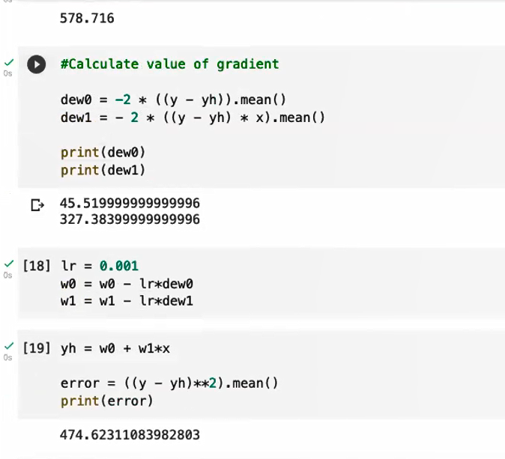
To make step size small, we will multiply error gradient with the learning rate.
Here, we assumed Learning rate value to be 0.001
i.e. lr=0.001
And we multiplied it with both error gradients dew0 and dew1.
Now we can see, error came down from 578 to 474.

Slide 50
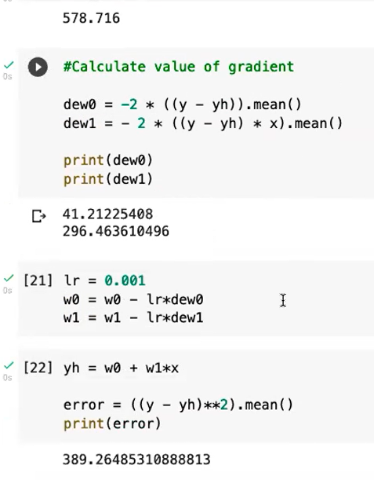
Re-run the above three cells again and you can see error further reduces to 389

Slide 51
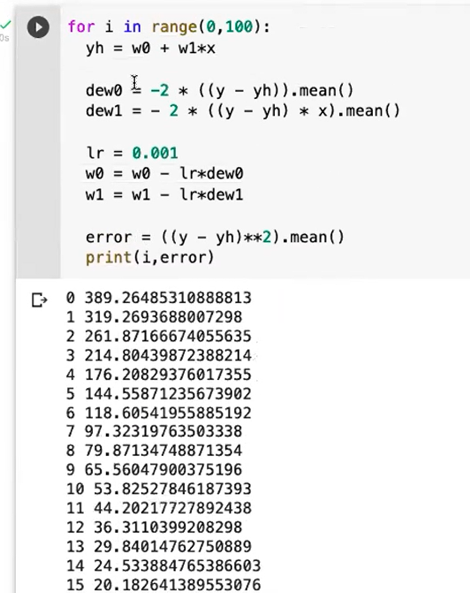
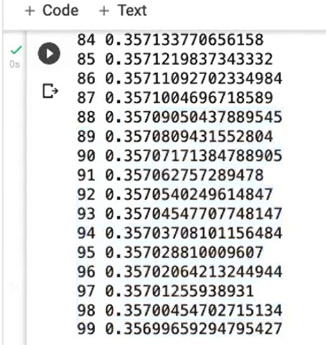
Run the same set of code 100 times to minimize the error
The error further reduces to 0.35

Slide 52
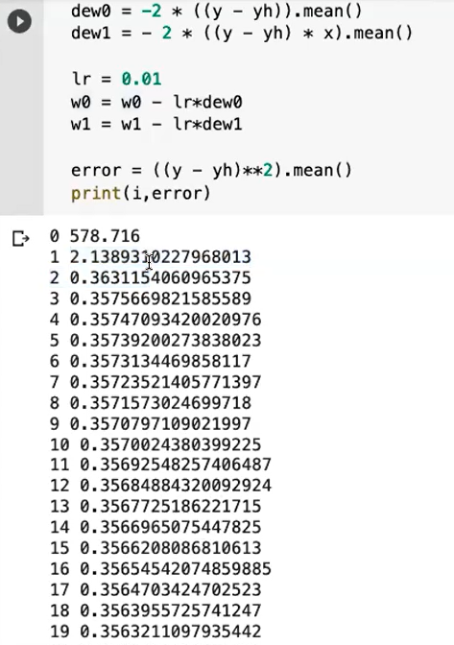
If we think that the learning is very slow, we can increase the learning rate… What happens if we increase the learning rate??
If we make Learning Rate (lr) from 0.001 to 0.01, error becomes 2.13 from 578 (only in 1 iteration)
Can we increase lr further???

Slide 53
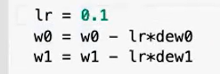
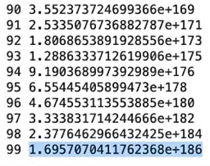
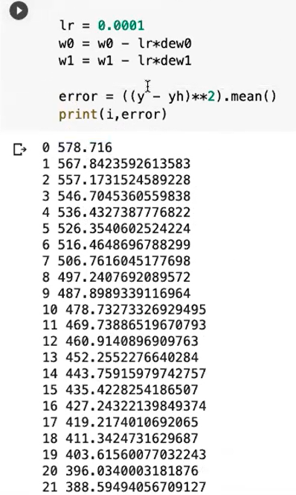
If we increase lr further from 0.01 to 0.1, error increases heavily …
For very small values of lr (Learning Rate), the optimization becomes very very slow.

Slide 54
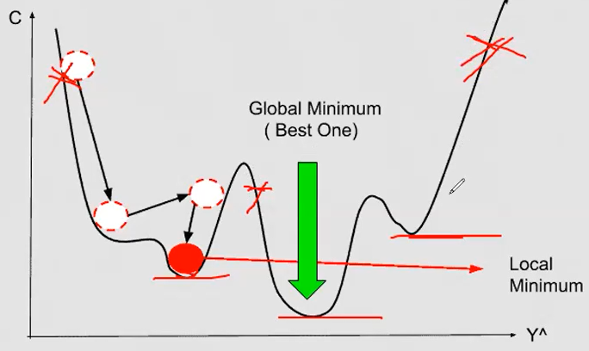
Too low learning rate will converge very slowly and too large learning rate may not converge at all. So there must be a optimal value of learning rate to converge at a proper speed.
If error converges, it will be a minima on the error curve for some values of w0 and w1.
Will it be a local minima or a global minima?? There can be multiple minimas on the curve, we must search for the global minima which is minimum of all the minima.
Where we will reach will be decided by from where we have started.

Slide 55

We can change the initial values of w0=3 and w1=4 to something else…
Starting from w0=3 and w1=4, after 100 iterations, we get values of w0 and w1 as shown below:-.

Slide 56


We can change the initial values of w0=3 and w1=4 to something else…
Starting from w0=3 and w1=4, after 100 iterations, we get values of w0 and w1 as shown below:-.
For w0=1, w1=2, we get more error for the same number of iterations. It means it is a local minima.
We can try various other combinations of w0 and w1 so that error should be minimum (Global Minima)

Slide 57


We can plot the curve
Best fit linear line by adopting Gradient Descent for Error minimization.
w0 and w1 are our trained parameters.

Slide 58

By using w0 and w1, which are our trained parameters, we can find any y-new for a given x-new.

Slide 59
Non Linear Regression
(Polynomial Regression)

Slide 60
Non Linear Regression
(Polynomial Regression)
Polynomial Regression is a special case of linear regression in which the relationship between the independent variable x and dependent variable y is modeled as an nth degree polynomial. The model function for polynomial regression is given as:
y = w₀ + w₁x + w₂x^2 + ... + w_{n}*x^n
where y is the dependent variable, x is the independent variable, w_{0,} w_{1,} w₂ , ..., w_{n} are the coefficients and n is the degree of the polynomial.

Slide 61

Non Linear Regression (Polynomial Regression)
Polynomial is:-
y_{h} = w₀ + w₁x + w₂x^2
X and Y has been reshaped to 5,1
Yh is now a polynomial equation
y is our target and (x, x**2) is our feature set

Slide 62

Non Linear Regression (Polynomial Regression)

Slide 63

Non Linear Regression (Polynomial Regression)

Slide 64

Non Linear Regression (Polynomial Regression)
Error is high, so we will adjust the learning rate

Slide 65

Non Linear Regression (Polynomial Regression)
Error becomes smaller as we adjusted the learning rate from 0.001 to 0.0001

Slide 66


Non Linear Regression (Polynomial Regression)
Putting it all together in a loop:-
Error starts to decrease…
and came down to 14.424

Slide 67


Non Linear Regression (Polynomial Regression)
Error further decreased when we increased the number of iterations in the For loop to 1000.
Error came down to 6.25

Slide 68

Non Linear Regression (Polynomial Regression)
Error further decreased when we initialized w0, w1 and w2 with different values:-
W0=1, w1=2, w2=1.5
Error came down to 0.45

Slide 69


Non Linear Regression (Polynomial Regression)
Values of w0, w1 and w2 are printed and curve for x and yh is plotted.

Slide 70
Linear Regression using Scikit-Learn library

Slide 71
Two methods to calculate Linear Regression
Method-1
Direct Formula (Closed Form Solution) (Ordinary Least Squares)
Scikit Learn uses this approach internally.
Linearregression() class of scikit-learn implements OLS (Ordinary Least Squares)
and not Gradient Descent approach
Method-2
Gradient Descent
It is better to be used in case of higher dimensios as such calculations in OLS becomes difficult.
SGDRegressor class of scikit-learn implements Gradient Descent.

Slide 72

Direct Formula (Closed Form Solution)
You are advised to compute m and b by using above formula and verify the results with the following method:-

Slide 73


CSV File

Slide 74


Slide 75



Slide 76


Writing into a csv file
areas.csv

Slide 77

Final prediction.csv file where Prices column has been filled with the predicted values.

Slide 78
Methods to avoid or minimize the overfitting in our Machine Learning Model:-
There are three most popular techniques to avoid overfitting in a model:- Bagging, Boosting & Regularization.
Bagging and Boosting are ensemble learning techniques that combine multiple models to improve performance, while
Regularization is a method that controls the complexity of the model to reduce overfitting.
These techniques are often used in combination to achieve the best possible performance.

Slide 79
Bagging (Bootstrap Aggregating): Bagging is a technique that involves creating multiple copies of the training data set by resampling with replacement. A new model is trained on each of the resampled data sets, and their predictions are combined using an averaging method to make the final prediction. Bagging can reduce overfitting by reducing the variance of the model.
Boosting: Boosting is a technique that involves creating a sequence of models, where each new model attempts to correct the errors of the previous model. The final prediction is made by combining the predictions of all the models. Boosting can reduce overfitting by reducing the bias of the model.
Regularization: Regularization is a technique that involves adding a penalty term to the loss function during model training to control the complexity of the model. The two most common types of regularization are L1 regularization (Lasso) and L2 regularization (Ridge).
L1 regularization shrinks some of the coefficients to zero, resulting in a more sparse model.
L2 regularization shrinks all of the coefficients toward zero, resulting in a more stable model.
Regularization can reduce overfitting by preventing the model from becoming too complex.

Slide 80
Types of Regression Techniques:-
Ridge (L2)
Lasso (L1)
Elastic Net (Combination of Ridge and Lasso)

Slide 81
Ridge Regression (Regularization Technique)
Regularization: It is a technique using which we induce some added information in a Machine Learning Model so that Overfitting can be avoided or minimized.
Ridge Regression is a type of linear regression that is used when the data suffers from multicollinearity, which means that the independent variables are highly correlated.
In multicollinearity, the coefficient estimates of the linear regression tend to be unstable.
Multicollinearity is a statistical phenomenon that occurs when two or more independent variables in a regression model are highly correlated with each other. In other words, multicollinearity indicates a strong linear relationship among the independent variables. This can create challenges in the regression analysis because it becomes difficult to determine the individual effects of each independent variable on the dependent variable accurately.
When multicollinearity is present, the estimated regression coefficients may become large and unpredictable, leading to unreliable inferences about the effects of the predictor variables on the response variable. Therefore, it is important to check for multicollinearity.

Slide 82
Ridge Regression (Regularization Technique)
Ridge Regression addresses this problem by adding a penalty term to the cost function of the linear regression model. This penalty term helps to reduce the variance of the estimates.
In Ridge Regression, the cost function is given as:
y = b₀ + b₁x₁ + b₂x₂ + ... + b_{n}x_{n} + α Σ(b_{i}**2)
where y is the dependent variable, x₁, x₂, ..., x_{n} are the independent variables, b₀, b₁, b₂, ..., b_{n} are the coefficients, α is the regularization parameter, and Σ(bi^2) is the sum of squares of the coefficients.

Slide 83
Ridge Regression (Regularization Technique)
To understand how Ridge Regression works, let's start with the standard linear polynomial regression model:
y = b₀ + b₁x₁ + b₂x₂ + ... + b_{n}x_{n} + e
Here, y is the dependent variable, x1, x2, ..., xn are the independent variables, b0, b1, b2, ..., bn are the coefficients or parameters of the model, and e is the error term or the residual.
The goal of linear regression is to estimate the values of the coefficients b0, b1, b2, ..., bn that best fit the data. This is done by minimizing the sum of the squared residuals, which is known as the residual sum of squares (RSS) Function:
RSS = Σ(yi - ŷi)**2
where yi is the observed value of the dependent variable, ŷi is the predicted value of the dependent variable, and the sum is taken over all the data points.

Slide 84
Ridge Regression (Regularization Technique)
In Ridge Regression, we add a regularization term to the Loss Function (RSS) to prevent the coefficients from becoming too large. The regularization term is given by:
α Σ(b_{i}**2)
where α is the regularization parameter, b_{i} is the i^{th} coefficient, and the sum is taken over all the coefficients.
The goal of Ridge Regression is to minimize the following cost function:
Cost/Loss Function (L) = Σ(yi - ŷi)**2 + α Σ(b_{i}**2)

Slide 85
Ridge Regression (Regularization Technique)
The cost function of Ridge regression is also known as the L2 regularization. It adds a penalty term to the ordinary least squares (OLS) cost function to shrink the coefficient estimates towards zero. The formula for the Ridge regression cost function is:
L(Loss Function) = Σ(yi - ŷi)**2 + α Σ(b_{i}**2)
Where:-
L is the cost function
Σ(yi - ŷi)**2 is the residual sum of squares of the OLS model
b_{i} is the vector of regression coefficients
α is the regularization parameter (hyperparameter) that controls the strength of the penalty term. (Zero to infinity)

Slide 86
Ridge Regression (Regularization Technique)
The regularization parameter α can be adjusted to balance the trade-off between the goodness of fit and the complexity of the model.
A higher value of α will lead to smaller coefficient estimates, which means a simpler model with less overfitting but potentially lower prediction accuracy.
Conversely, a lower value of α will lead to larger coefficient estimates and potentially better prediction accuracy but with a higher risk of overfitting.
If α = 0 then Ridge Regression is just Linear Regression.
If α is very large, then all weights end up very close to zero and the result is a flat line going through the data’s mean

Slide 87
Lasso Regression (Regularization Technique)
In Lasso regression, the penalty term is the L1 norm (i.e., the sum of the absolute values) of the coefficients, multiplied by a regularization parameter lambda. The goal of Lasso regression is to minimize the sum of the squared residuals between the predicted and actual values of the target variable, while also minimizing the L1 norm of the coefficients.
This can be useful for feature selection, as it allows us to identify the most important features for making predictions. Additionally, Lasso regression can improve model interpretability by making the model simpler and more transparent.
Compared to Ridge regression (which uses L2 regularization), Lasso regression tends to be more effective at selecting a subset of the most relevant features when there are many features with small to medium-sized effects. However, Lasso regression can be less effective when there are many features with large effects or when the features are highly correlated.

Slide 88
Lasso Regression (Regularization Technique)
We start with the linear regression equation:
yh = w₀ + w₁x₁ + w₂x₂ + ... + w_{n}x_{n} + e
Where:
yh is the target variable
x1, x2, ..., xn are the features or predictors
w0, w1, w2, ..., wn are the coefficients (or weights) that we want to estimate
e is the error term
The goal is to find the values of the coefficients that minimize the sum of the squared residuals:
minimize ||yi - yh||^2
Where yh is the predicted value of yi based on the features and the estimated coefficients.
In Lasso regression, we add a penalty term to the loss function to prevent the coefficients from getting too large. The penalty term is the L1 norm of the coefficients multiplied by a regularization parameter lambda:
minimize ||y - yh||^2 + lambda * ||w||1
Where ||w||1 is the L1 norm of the coefficients, which is the sum of the absolute values of the coefficients:
||w||1 = |w₁| + |w₂| + ... + |w_{n}|

Slide 89
Lasso Regression (Regularization Technique)
The first part of the cost function is the standard mean squared error loss, which measures the average difference between the predicted and actual values of y. The second part is the L1 regularization penalty, which adds a penalty term proportional to the sum of the absolute values of the coefficients.
The parameter lambda controls the strength of the penalty term. A higher value of lambda results in a stronger penalty, which makes the coefficients smaller and the model simpler. A lower value of lambda results in a weaker penalty, which allows the coefficients to be larger and the model more complex.

Slide 90
Lasso Regression (Regularization Technique)
Lasso regression is a linear regression technique that uses L1 regularization to penalize the absolute values of the coefficients and reduce the complexity of the model. The cost function of Lasso regression includes a standard mean squared error loss and a penalty term proportional to the sum of the absolute values of the coefficients.
The goal of Lasso regression is to find the values of the coefficients that minimize the cost function, which can be achieved using an optimization algorithm such as gradient descent.

Slide 91
Elastic Net Regression (Regularization Technique)
We start with the linear regression equation:
y = w₀ + w₁x₁ + w₂x₂ + ... + w₀x_{n} + e
Where:
y is the target variable
x₁, x₂, ..., x_{n} are the features or predictors
w₀, w₁, w₂, ..., w_{n} are the coefficients (or weights) that we want to estimate
e is the error term
The goal is to find the values of the coefficients that minimize the sum of the squared residuals:
minimize ||y - yh||^2
Where yh is the predicted value of y based on the features and the estimated coefficients.

Slide 92
Elastic Net Regression (Regularization Technique)
Elastic Net regression is a linear regression technique that combines the L1 and L2 regularization methods to prevent overfitting and improve the generalization performance of the model. The regularization term is a combination of the L1 and L2 norms of the coefficients, multiplied by two separate regularization parameters, alpha and lambda.
minimize ||y - yh||^2 + alpha * lambda * ||w||1 + (1 - alpha) * lambda * ||w||2^2
where ||w||1 is the L1 norm of the coefficients, which is the sum of the absolute values of the coefficients:
||w||1 = |w₁| + |w₂| + ... + |w_{n}|
And ||w||₂^2 is the L2 norm of the coefficients, which is the sum of the squared values of the coefficients:
||w||₂^2 = w₁^2 + w₂^2 + ... + w_{n}^2

Slide 93
Elastic Net Regression (Regularization Technique)
The parameter lambda controls the strength of the penalty term. A higher value of lambda results in a stronger penalty, which makes the coefficients smaller and the model simpler.
The parameter alpha controls the relative weight of the L1 and L2 penalties. A value of alpha=1 corresponds to Lasso regression, while a value of alpha=0 corresponds to Ridge regression.
To minimize the cost function, we can use optimization techniques such as gradient descent.

Slide 94
Logistic Regression
Logistic regression is one of the most popular Machine Learning algorithms, which comes under the Supervised Learning technique. It is used for predicting the categorical dependent variable using a given set of independent variables.
Logistic regression predicts the output of a categorical dependent variable. Therefore the outcome must be a categorical or discrete value. It can be either Yes or No, 0 or 1, true or False, etc. but instead of giving the exact value as 0 and 1, it gives the probabilistic values which lie between 0 and 1.
Logistic Regression is much similar to the Linear Regression except that how they are used. Linear Regression is used for solving Regression problems, whereas Logistic regression is used for solving the classification problems.

Slide 95

Logistic Regression
In Logistic regression, instead of fitting a regression line, we fit an "S" shaped logistic function, which predicts two maximum values (0 or 1).
Logistic Regression is a significant machine learning algorithm because it has the ability to provide probabilities and classify new data using continuous and discrete datasets.
Logistic Regression can be used to classify the observations using different types of data and can easily determine the most effective variables used for the classification. The below image is showing the logistic function:

Slide 96

Logistic Regression
Logistic Regression Equation:
The Logistic regression equation can be obtained from the Linear Regression equation. The mathematical steps to get Logistic Regression equations are given below:
We know the equation of the straight line can be written as:
In Logistic Regression y can be between 0 and 1 only, so for this let's divide the above equation by (1-y):
But we need range between -[infinity] to +[infinity], then take logarithm of the equation it will become:
The above equation is the final equation for Logistic Regression.

Slide 97

Logistic Regression
Logistic Function (Sigmoid Function):
The sigmoid function is a mathematical function used to map the predicted values to probabilities.
It maps any real value into another value within a range of 0 and 1.
The value of the logistic regression must be between 0 and 1, which cannot go beyond this limit, so it forms a curve like the "S" form. The S-form curve is called the Sigmoid function or the logistic function.
In logistic regression, we use the concept of the threshold value, which defines the probability of either 0 or 1. Such as values above the threshold value tends to 1, and a value below the threshold values tends to 0.

Slide 98

Logistic Regression
Logit Function:
A simple yet effective tool for classification tasks is the logit model. This model is often used as a baseline/benchmark approach before using more sophisticated machine learning models to evaluate the performance improvements.

Slide 99

Logistic Regression
The logistic regression takes the output of a linear function of k independent variables and uses the logistic link function to output this value within the range of [0,1].

Slide 100

Logistic Regression
Odds_Ratio=$\frac{P}{1−P}$
Where P stands for the Probability of positive event.
$$logit\left(p\right)=log\frac{p}{(1−p)}$$
$$logit\left(p\left(y=1 | x\right)\right)=wTx$$
To predict the probability whether a sample belongs to certain class, take the inverse of logit function.
$$∅\left(z\right)=\frac{1}{1+e^{−z}}$$
Where z is net input.
$$z=wTx=w0+w1x1+…+wmxm$$

Slide 101

Decision Boundary
Set threshold to predict the class of sample.
Can be linear or non-linear.
Increase polynomial order to get complex decision boundary.

Slide 102

Cost Function
$$j\left(w\right)=\sum_{i=1}^{n}{−log\left(∅\left(z^{\left(i\right)}\right)\right)−\left(1−y^{\left(i\right)}\right)log(i−∅\left(z^{\left(i\right)}\right))}$$
$$j\left(∅\left(z\right),y;w\right)=\left\{\begin{aligned}−log\left(∅\left(z\right)\right) if y=1 \\ −log\left(1−∅\left(z\right)\right) if y=0\end{aligned}\right.$$

Slide 103

Weight Updating in Logistic Regression
$$wj=wj+ƞ\sum_{i=1}^{n}{(y^{\left(i\right)}−∅\left(z^{\left(i\right)}\right))x^{(i)}}$$
$$w≔w+∆w$$
$$∆wj=−ƞ\frac{∂J}{∂wj}=ƞ\sum_{i=1}^{n}{(y^{\left(i\right)}}−∅(z^{\left(i\right)})x^{\left(i\right)})$$

Slide 104
Logistic Regression
Logistic regression is a classification technique, not a regression technique. Although the name "regression" is used in the name, it is actually a binary classification algorithm that predicts the probability of a binary outcome (i.e., 0 or 1).
The logistic regression model estimates the probability of the positive class (i.e., class 1) using a logistic function, which maps the linear combination of the input features and the model coefficients to a value between 0 and 1. The predicted class label is then determined by applying a decision threshold to the predicted probability.

Slide 105
Logistic Regression
Type of Logistic Regression:
On the basis of the categories, Logistic Regression can be classified into three types:
Binomial: In binomial Logistic regression, there can be only two possible types of the dependent variables, such as 0 or 1, Pass or Fail, etc.
Multinomial: In multinomial Logistic regression, there can be 3 or more possible unordered types of the dependent variable, such as "cat", "dogs", or "sheep"
Ordinal: In ordinal Logistic regression, there can be 3 or more possible ordered types of dependent variables, such as "low", "Medium", or "High".

Slide 106


Logistic Regression

Slide 107

Logistic Regression

Slide 108

Logistic Regression

Slide 109

Logistic Regression
Scatter Plot of the data

Slide 110

Logistic Regression
A line is drawn by using Linear Regression

Slide 111

Logistic Regression
A dotted line has been drawn at centre

Slide 112

Logistic Regression
Outlier at Age >80
Issue with circled data points. Actual value is Yes but predicted value is No Insurance

Slide 113

Logistic Regression
Instead of Linear Line a curve has been drawn that is much better fit than the previous straight line.
This curve represents Sigmoidal Function

Slide 114

Logistic Regression

Slide 115

Logistic Regression
Straight Line Equation
Feeding Straight line equation in a Signoid function we gat a S shape line that fits well.

Slide 116

Logistic Regression
CSV file of Insurance data

Slide 117

Logistic Regression

Slide 118

Logistic Regression

Slide 119

Logistic Regression

Slide 120

Logistic Regression

Slide 121


Logistic Regression

